Slide 1

3-5th Grade Lesson
November/December 2025

Slide 2
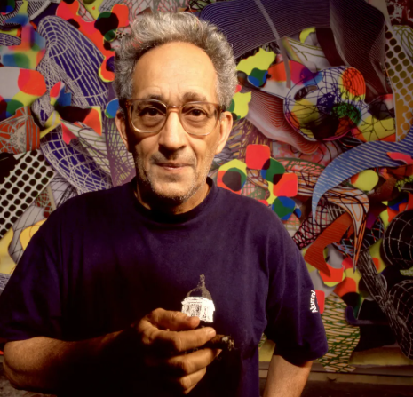
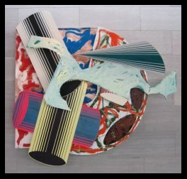
Frank Stella
May 12, 1936-May 4, 2024
American painter, sculptor and printmaker born from Italian-American parents
Lived mostly in New York

Slide 3
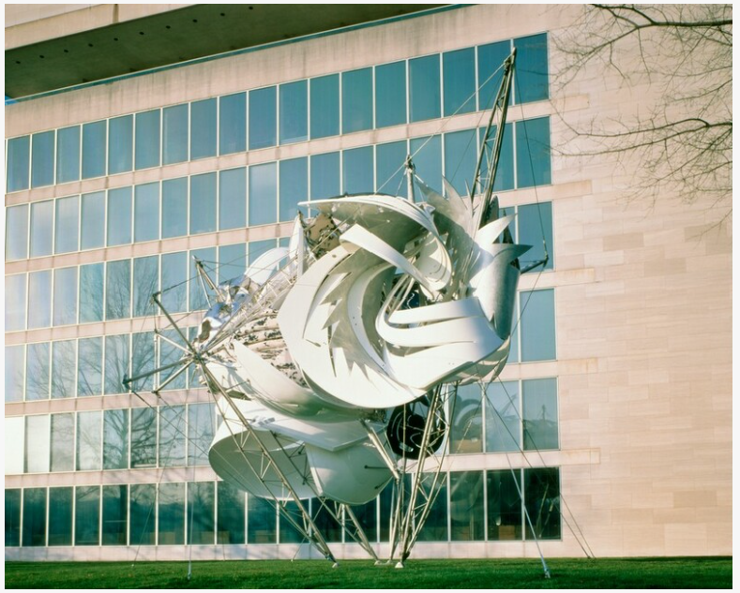
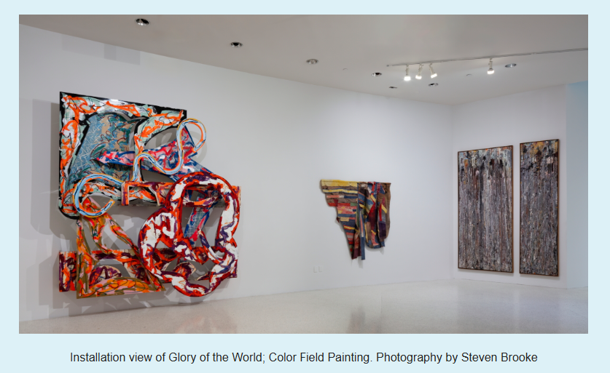
Frank Stella Videos –
6 minutes – Life Overview
4 minutes – Interview w/Frank

Slide 4
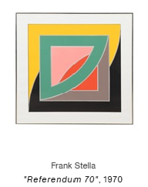
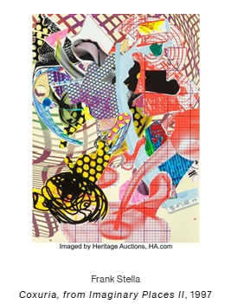
Minimalist – super simple art using only the most important parts
Op Art – style of art using optical illusions
Pop Art – art made from commercial items and cultural icons such as product labels and movie stars
Abstract Expressionism– type of art where artists paint their feelings and emotions instead of drawing real things

Slide 5
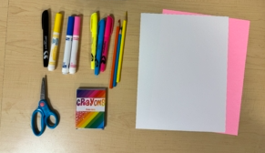
Supplies:
Drawing Pencil
Drawing Paper
Mounting paper
Colored Pencils
Colored Markers
Scissors
Glue Stick

Slide 6
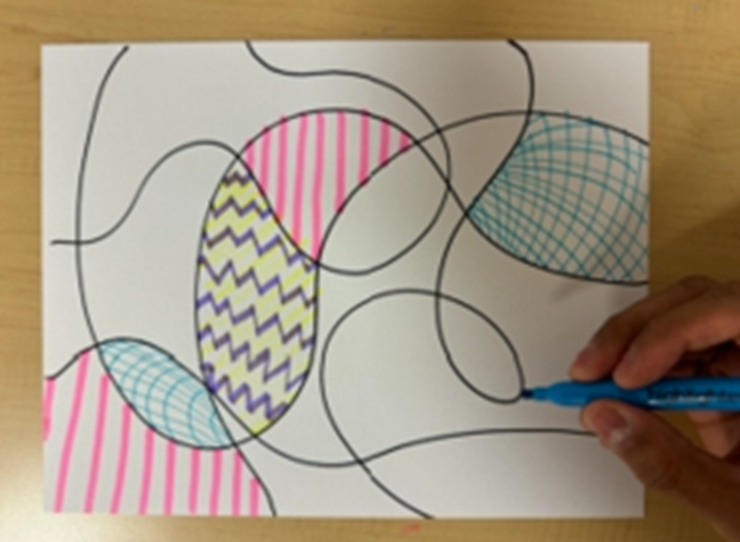
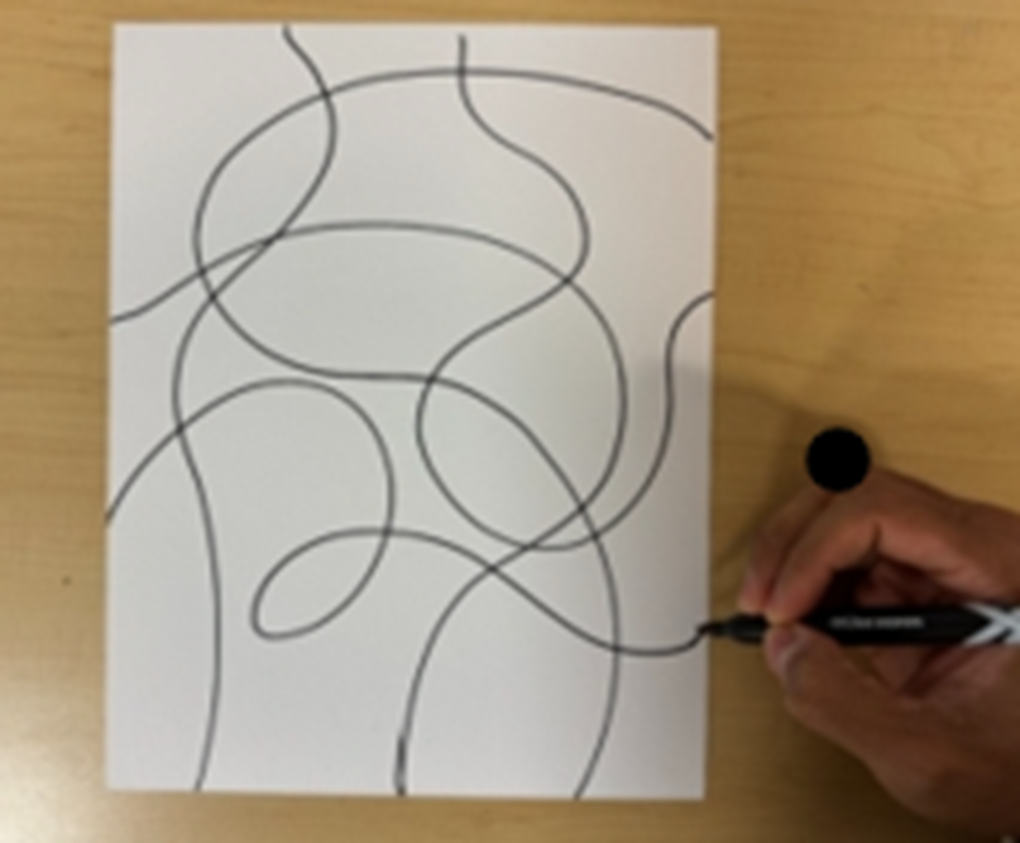
Step 2
Step 1
Use your marker and colored pencils to fill in the organic shapes you made. Repeat on other side if time permits.
Use a black marker to draw squiggly lines overlapping one another, from one side to another.

Slide 7
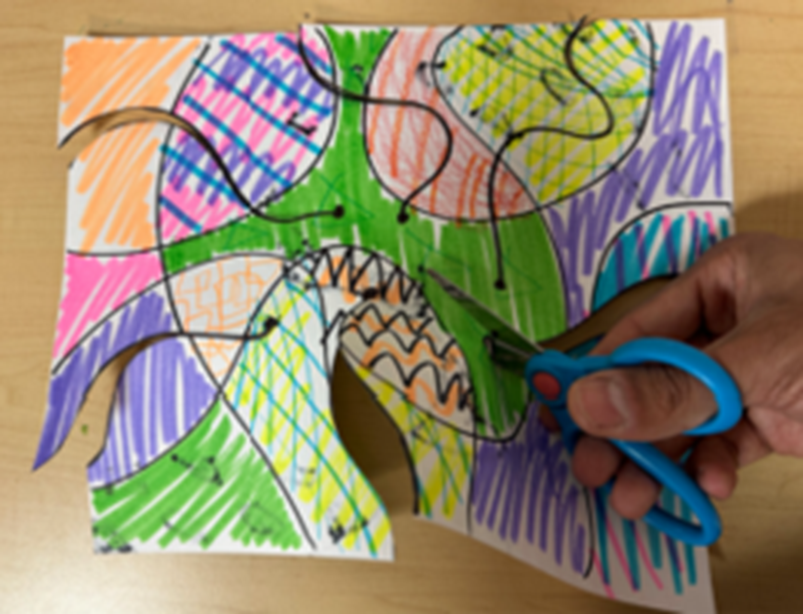
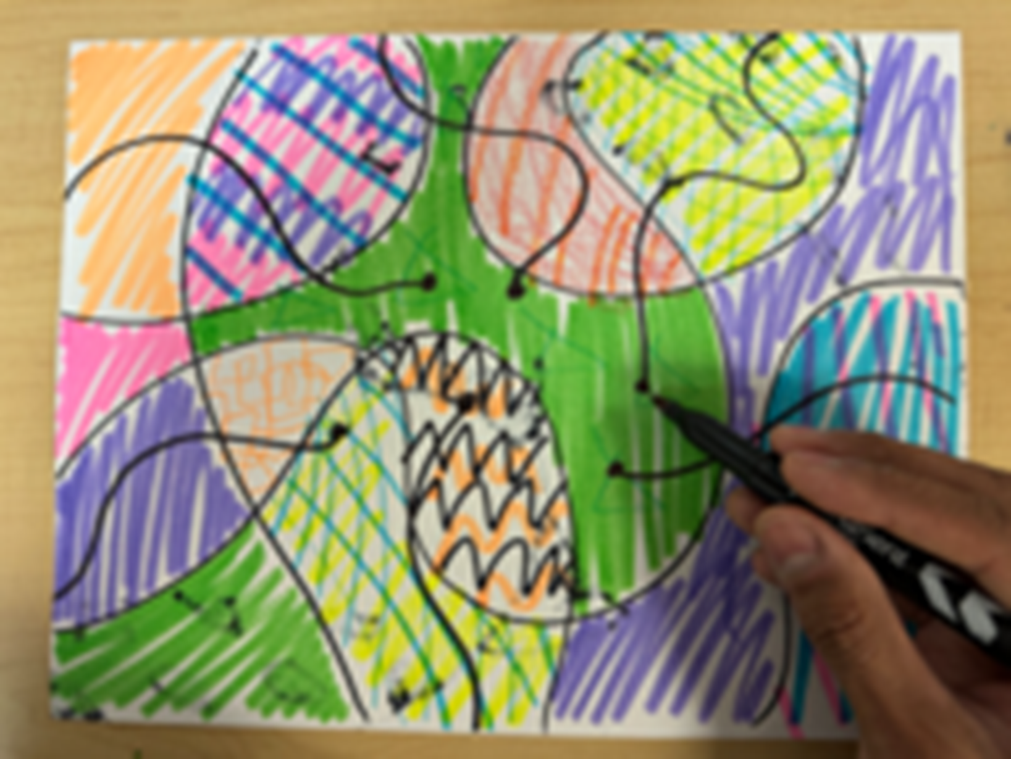
Step 3
Step 4
Draw shorter squiggly lines that move towards the center of the page. The lines should end with a point/dot.
Hint - doing this in another color will sometimes help it stand out.
Cut along the squiggly lines and stop at the end point.

Slide 8
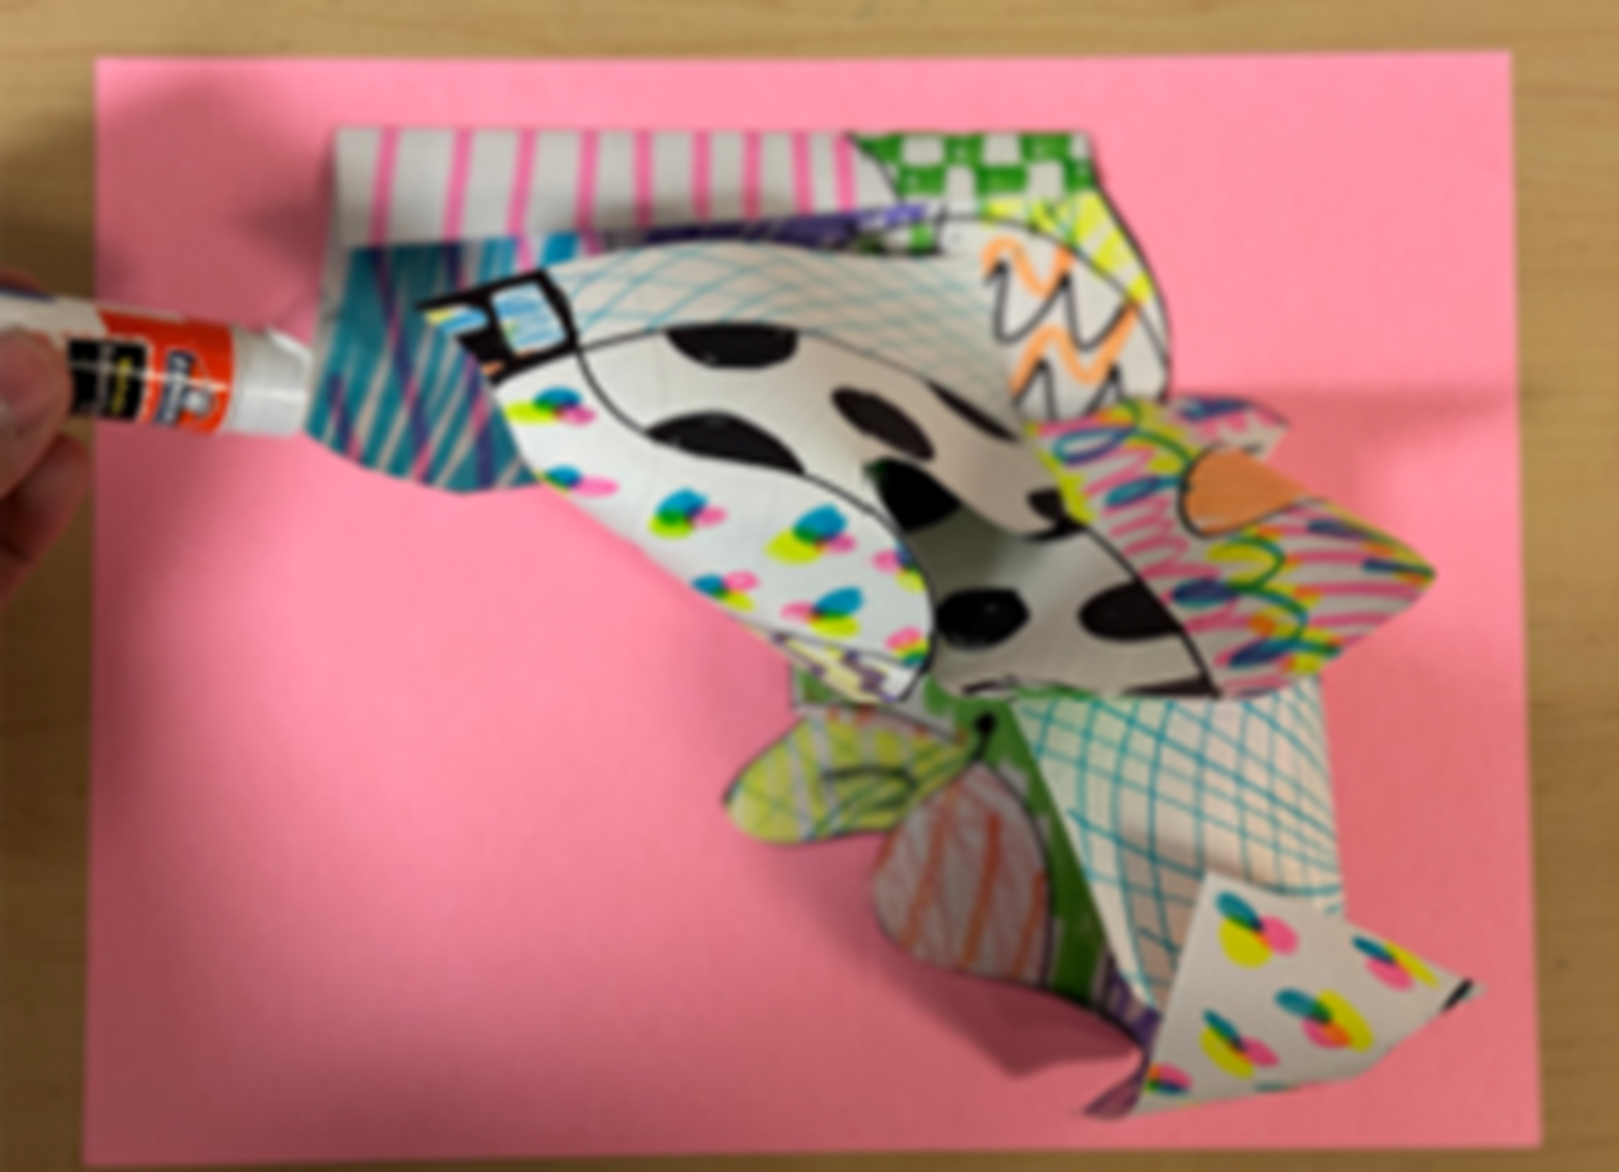
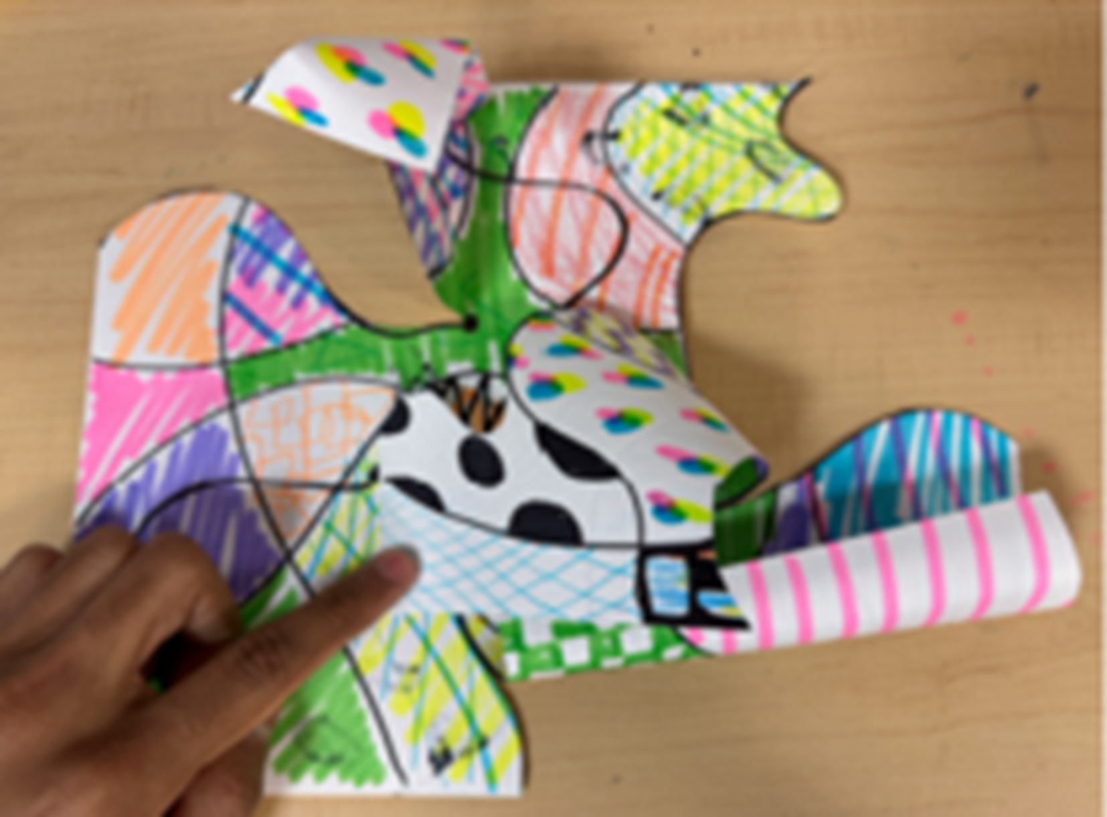
Step 5
Step 6
Roll, or fold the loose tabs inward toward the center, and attach them using glue.
Glue the paper sculpture to your base – the end!

