Slide 1
3-5th Lesson
October 2024
Brought to the classrooms by:
The Woodside PTA and volunteers

Slide 2
SONIA DELAUNAY NOV 14, 1885 – DEC 5, 1979
Sonia was born in a Ukrainian village and was originally named Sara Stern.
Sara became Sonia at the age of 7 after joining her uncle in St Petersburg, Russia.
Sonia was the first woman to ever have an art show in the Louvre Museum in France

Slide 3
Videos
3 Minute Video

Slide 4
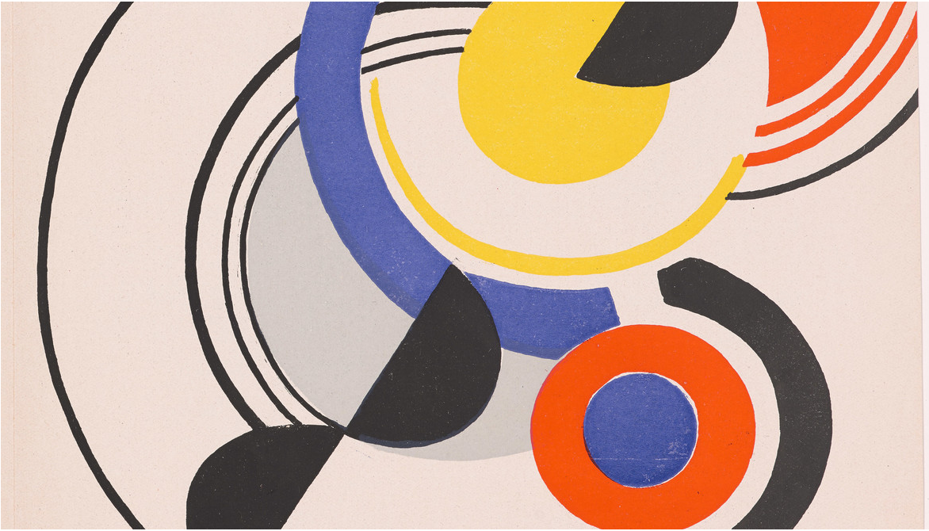
Sonia studied art in Germany as a teenager, but then moved to Paris to continue her art studies and married Robert Delaunay.
Sonia and her husband developed “Simultanism” – a mode of art centered on the “simultaneous contrast” of colors using concentric circles. A form of abstract art.
Abstract Art – art that does not attempt to represent reality, but seeks to achieve its effect using shapes, forms, colors and textures

Slide 5
Simultaneous contrast – tendency of a color to bring out its opposite appearance
Concentric Circles – circles with a common center

Slide 6
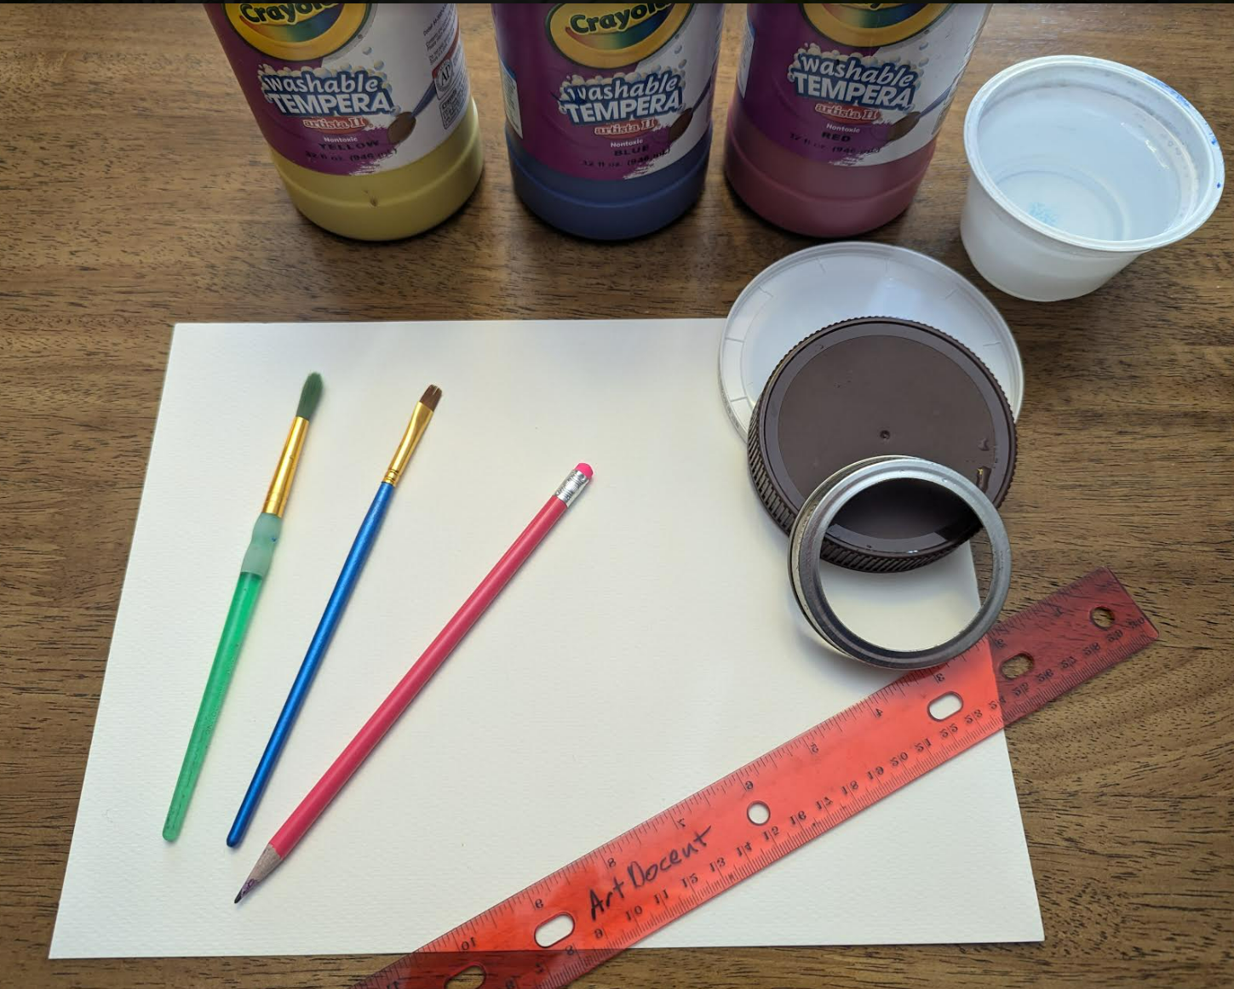
Supplies:
Pencil
Ruler
Paper
Circle lids of various sizes
Washable Paint
Paint Brushes
Paper towels for blotting paint
Large manilla paper to protect
your table

Slide 7
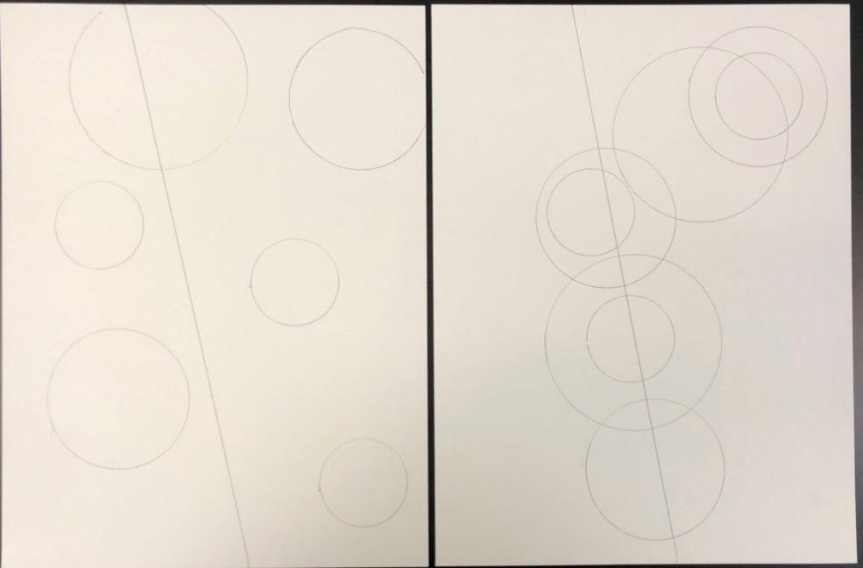
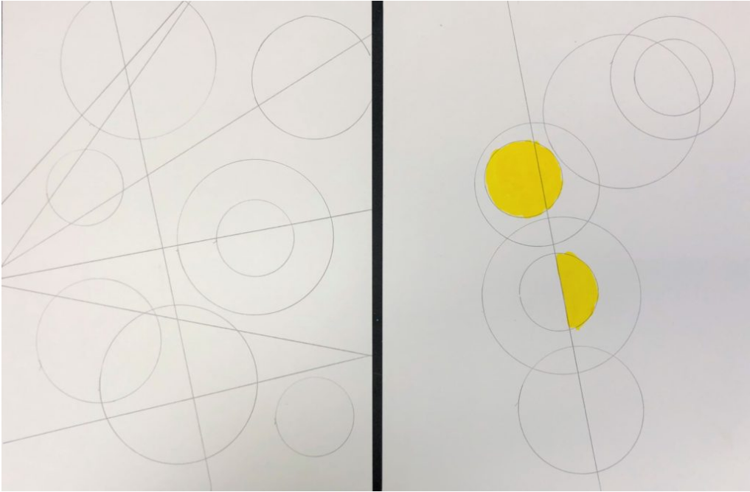
Place construction paper on top of your placemat desk protector
Draw a diagonal line across your paper splitting it into two sections with a pencil
Choose 2-3 circles
Draw 3-5 circles and partial circles of different sizes along the diagonal line with a pencil
5. Paint circles using contrasting colors for circles or partial circles on the different sides of the diagonal line

Slide 8
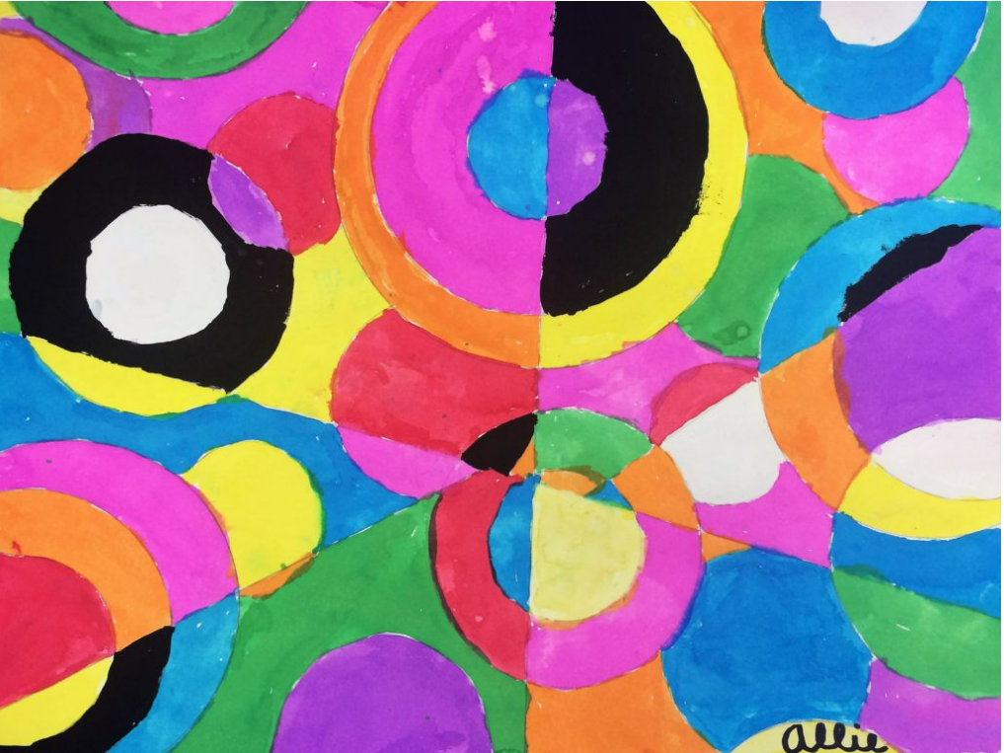
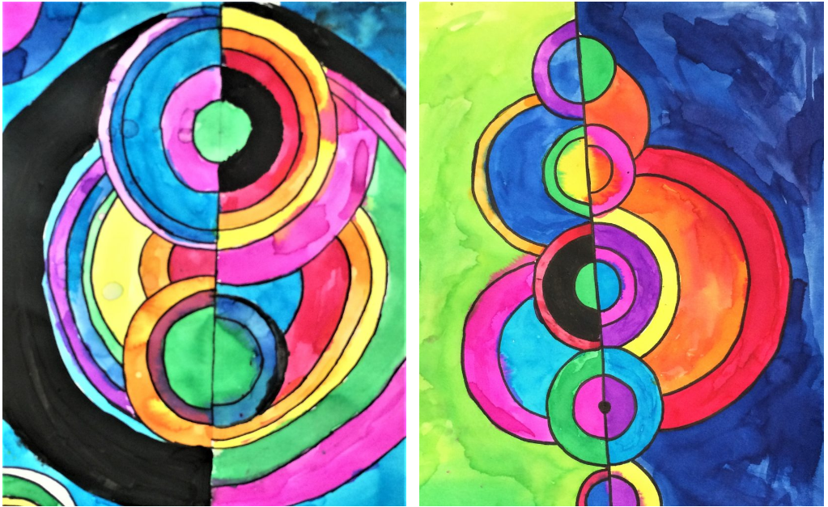
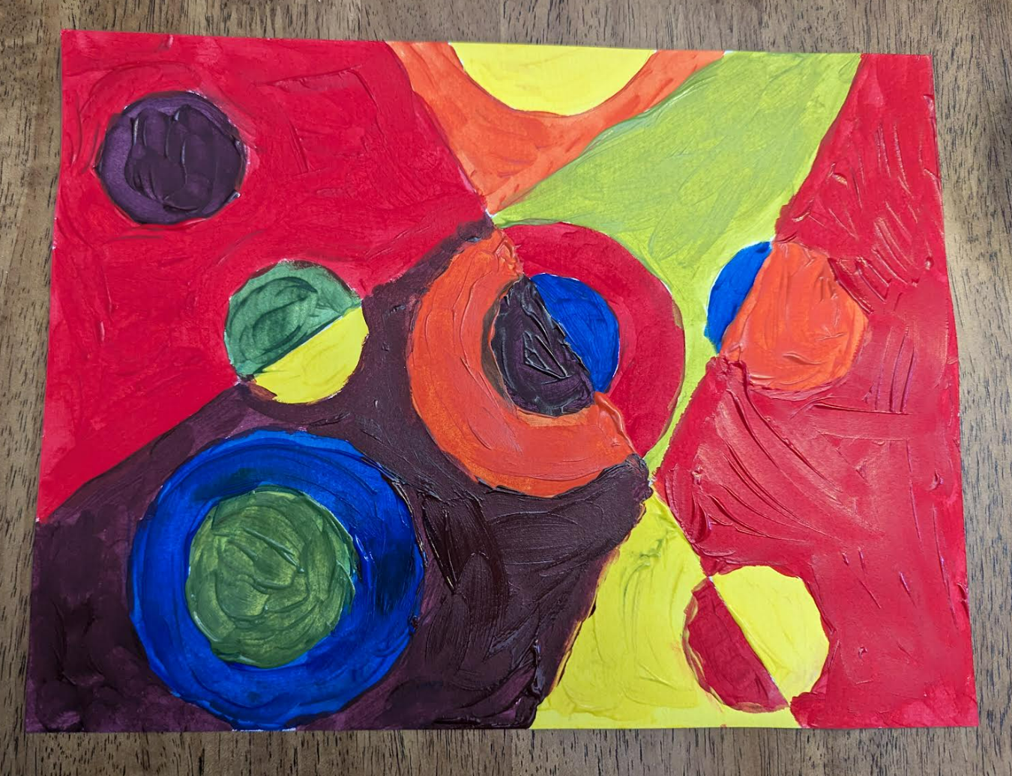
Examples

