Slide 1
K-2nd Lesson
October 2024
Brought to the classrooms by:
The Woodside PTA and volunteers

Slide 2
SONIA DELAUNAY NOV 14, 1885 – DEC 5, 1979
Sonia was born in a Ukrainian village and was originally named Sara Stern.
Sara became Sonia at the age of 7 after joining her uncle in St Petersburg, Russia.
Sonia was the first woman to ever have an art show in the Louvre Museum in France

Slide 3
Videos
3 Minute Video

Slide 4
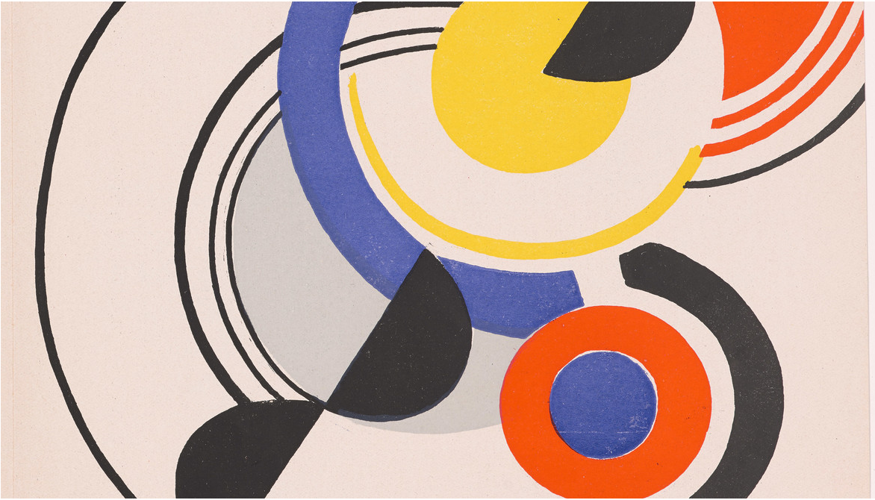
Sonia studied art in Germany as a teenager, but then moved to Paris to continue her art studies and married Robert Delaunay.
Sonia and her husband developed “Simultanism” – a mode of art centered on the “simultaneous contrast” of colors using concentric circles. A form of abstract art.
Abstract Art – art that does not attempt to represent reality, but seeks to achieve its effect using shapes, forms, colors and textures

Slide 5
Simultaneous contrast – tendency of a color to bring out its opposite appearance
Concentric Circles – circles with a common center

Slide 6
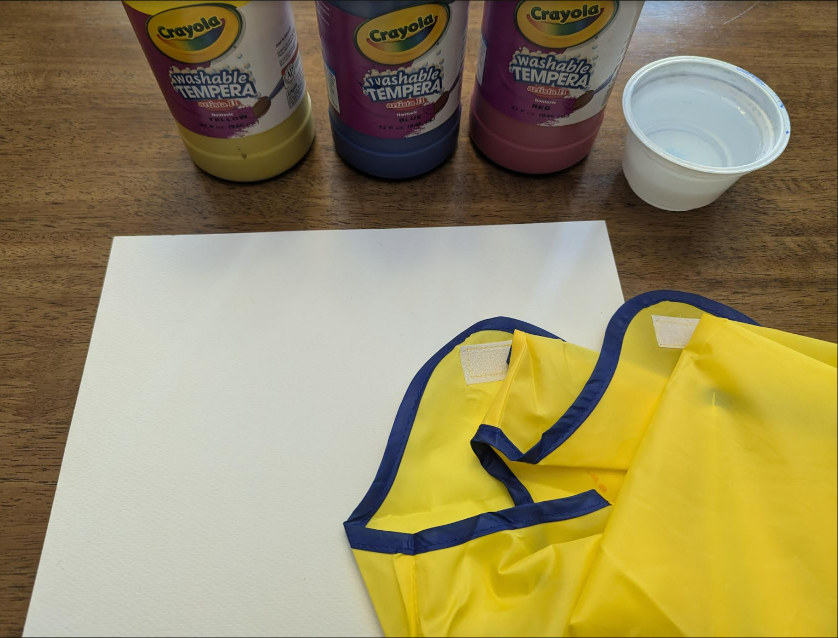
Supplies:
Paper
Paint
Paper towels
Smock to protect clothes
Baby wipes
Large manilla paper to protect
your table

Slide 7
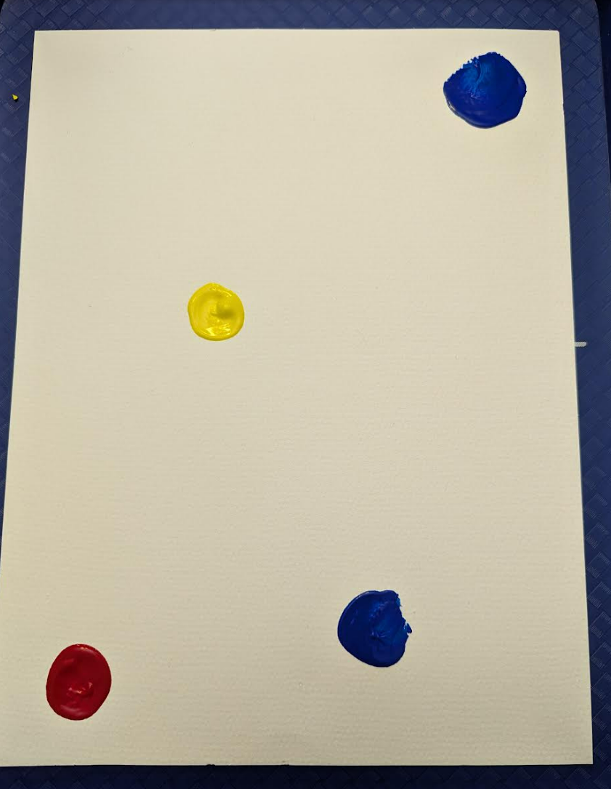
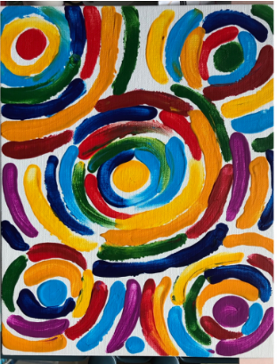
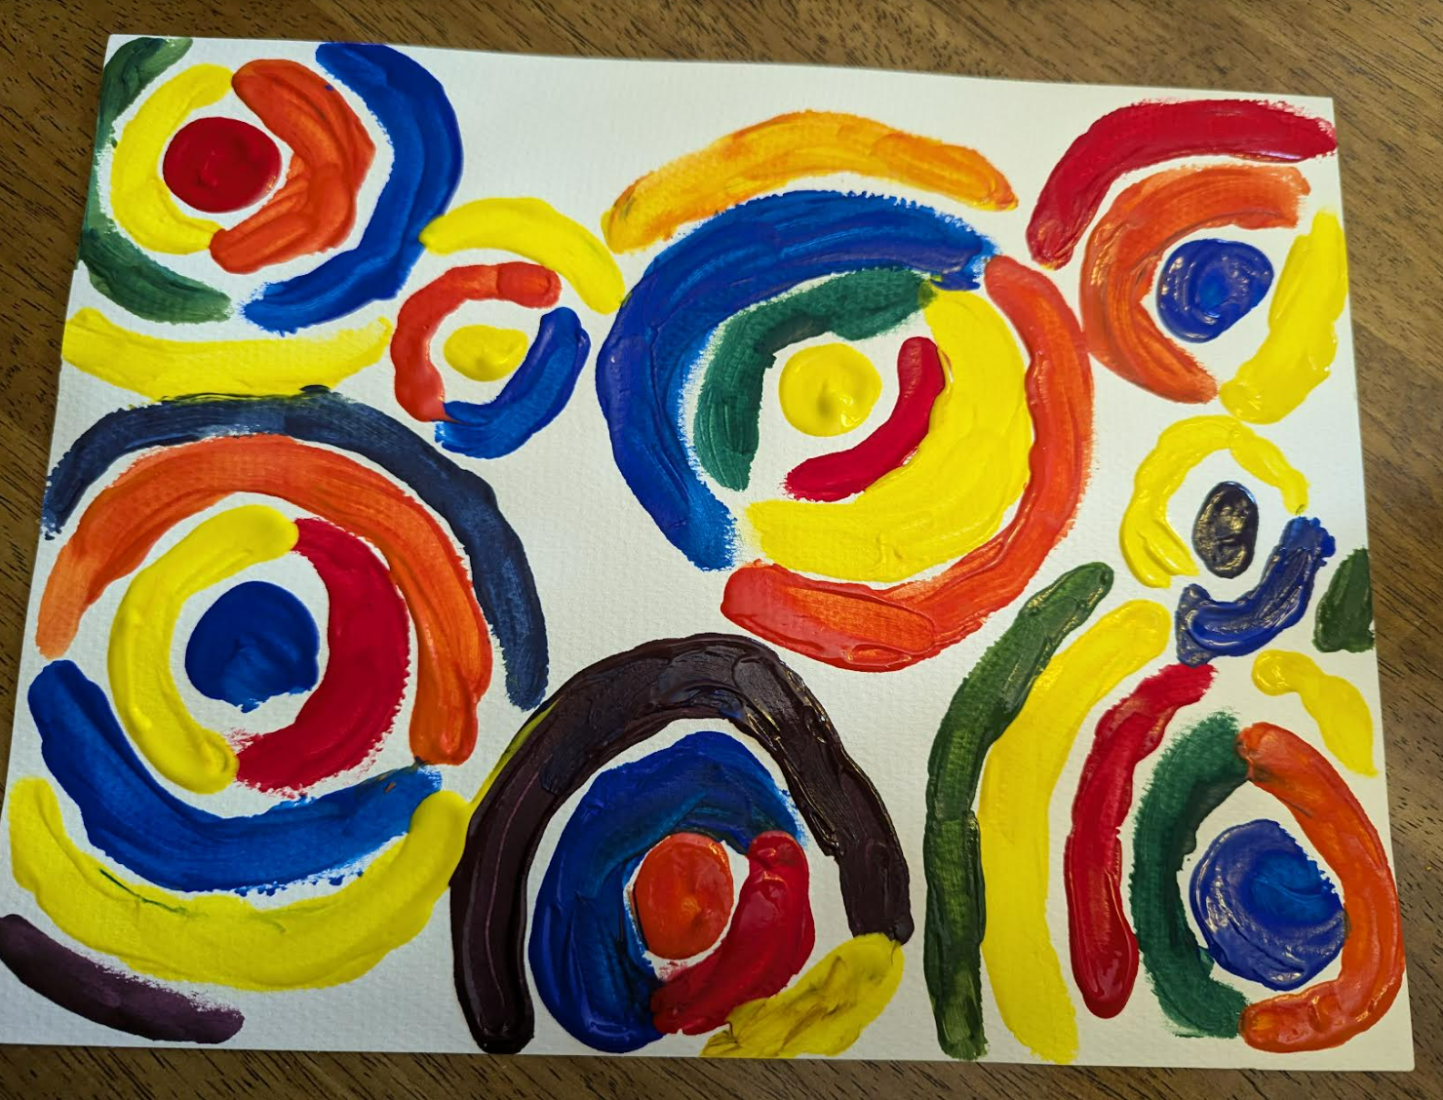
Place construction paper on top of your placemat desk protector
Paint 3-5 circles of different colors randomly across the paper
Trace around each circle part ways with different colors of paint
Finish the circle with another color of paint (or two) making sure to clean off your finger between colors
5. Continue to paint multi-colored circles around the original circles until the page is mostly full

